Slide 1

CET2011A -Operating Systems
School of Computer Engineering and technology

Slide 2

Lab Assignment 3 FCFS CPU Scheduling
Problem Statement : FCFS CPU Scheduling
Write a program to simulate the First Come First Serve ( Non Pre-emptive) CPU Scheduling algorithm

Slide 3
First Come First Serve (FCFS) ( Non Pre-emptive)

Slide 4
First Come First Serve (FCFS) ( Non Pre-emptive)
Processes with arrival times and burst time
Given n processes with their burst times and arrival times.
The task is to find average waiting time and average turn around time using FCFS scheduling algorithm.
FCFS simply queues processes in the order they arrive in the ready queue.
Here, the process that comes first will be executed first and next process will start only after the previous gets fully executed.

Slide 5
First Come First Serve (FCFS) ( Non Pre-emptive)
Completion Time
Time at which process completes its execution.
Turn Around Time
Time Difference between completion time and arrival time.
Turn Around Time = Completion Time – Arrival Time
Waiting Time(W.T)
Time Difference between turn around time and burst time.
Waiting Time = Turn Around Time – Burst Time

Slide 6
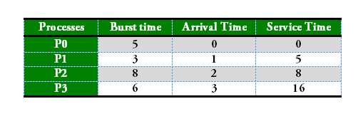
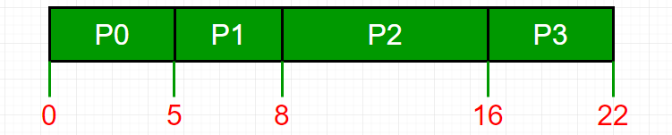
First Come First Serve (FCFS) ( Non Pre-emptive)
Service Time : Service time means amount of time after which a process can start execution.
It is summation of burst time of previous processes (Processes that came before)

Slide 7
First Come First Serve (FCFS) ( Non Pre-emptive)
To find waiting time:
Time taken by all processes before the current process to be started
(i.e. burst time of all previous processes) – arrival time of current process
wait_time[i] = (bt[0] + bt[1] +…… bt[i-1] ) – arrival_time[i]
Process Wait Time : Service Time - Arrival Time
P0 0 - 0 = 0
P1 5 - 1 = 4
P2 8 - 2 = 6
P3 16 - 3 = 13
Average Wait Time: (0 + 4 + 6 + 13) / 4 = 5.75

Slide 8
First Come First Serve (FCFS) ( Non Pre-emptive)
Implementation
Input the processes along with their burst time (bt) and arrival time (at).
Find waiting time (wt) for all processes. i.e. for a given process i:
wt[i] = (bt[0] + bt[1] + . . . . . + bt[i-1]) - at[i] .
Now find turnaround time = waiting_time + burst_time for all processes.
Find average waiting time = total_waiting_time / no_of_processes.
Similarly, find average turnaround time = total_turn_around_time / no_of_processes.

Slide 9
First Come First Serve (FCFS) ( Non Pre-emptive)
Output
Processes Burst time Arrival Time Waiting time Turn-around time Completion Time
P0 5 0 0 5 5
P1 9 3 2 11 14
P2 6 6 8 14 20
Average waiting time = 3.33333
Average turn around time = 10.0

